Slide 1
School Budgets SY 2023-2024
January – March 2023
Notes:
Superintendent kicks off the meeting:
Welcome to the Annual School Budgets Engagement Sessions.
I am Superintendent ___, and am happy to be here with our Senior Grants Officer or Senior Grants Officer, Sonny, who supports our schools directly with all matters related to budgets. (opportunity to personalize with a vision for the district, transparency, etc.)
Every spring, the Panel for Educational Policy (PEP) votes on the DOE budget-allocation formula for the following fiscal year. In preparation for this event, superintendents and borough based support staff present the DOE’s proposed FSF budget allocations for FY 2024 to all Community and Citywide Education Councils (CCECs).
The purpose of today's presentation is to review the DOE's budget and allocation formula, review Fair Student Funding and the proposed changes for fiscal year 2024, which aligns with the 2023-2024 school year.
This presentation marks a new approach in how NYC Public Schools is conducting community engagement around our school budgets and any proposed changes to the Fair Student Funding Formula. Our goal is to increase our transparency in ensuring that you, as critical community stakeholders, are made aware of how schools are funded and made aware of the resources available to you to better understand your school budgets.
Our new approach is a change that was one of a few recommendations made by the Fair Student Funding Working Group. Convened in July 2022 at the request of the Chancellor, the FSF Working Group worked over the course of four months, in partnership with national school finance experts and our own Finance team to deeply understand the current Fair Student Funding Formula, look at NYC School demographics and make recommendations for changes to the formula. The Working Group included a wide range of stakeholders, including CEC members, PEP members, union leaders, advocates, parents and elected officials. The Working Group published a report in November 2022 to make recommendations to the Chancellor for changes to the formula, which he considered and determined a few recommendations to move forward with. We will be discussing those changes in this presentation shortly.
In addition to recommendations to change the formula, the Working Group also asked that we work intentionally to better engage the community about school budgeting, the Fair Student Funding Formula, and how money to schools is allocated within this formula. This presentation marks a shift in our approach and demonstrates our commitment to the recommendations of the Working Group to focus on our transparency and community engagement.
I appreciate joining your meeting today and will dive into this presentation. Now, onto the agenda.

Slide 2
Agenda
Purpose
Review the DOE's budget
Review Fair Student Funding
Proposed Changes for FY 2024
Notes:
Today, I am going to be discussing three main topics:
sharing an overview of this year’s overall NYC Public Schools budget,
providing a detailed explanation of the Fair Student Funding Formula and
discussing the proposed changes to the Fair Student Funding Formula for the 23/24 school year.
If you have questions during the presentation, I am going to ask you to direct them to the chat (if in person, hold questions to the end). We will have team members ready to respond to these questions.
Questions that we are not able to answer during the presentation will be collected and shared with the NYC Public School’s team, who will then respond and I will share back with the group.
Additionally, the intention of this session is to collect public comments on our proposed changes. We ask that if you have specific feedback on the proposed changes to the Fair Student Funding Formula that you please feel free to share that feedback with BudgetPublicComments@schools.nyc.gov.
Our NYC Public Schools Team will be taking public comments received at this email address into consideration in the coming weeks.

Slide 3
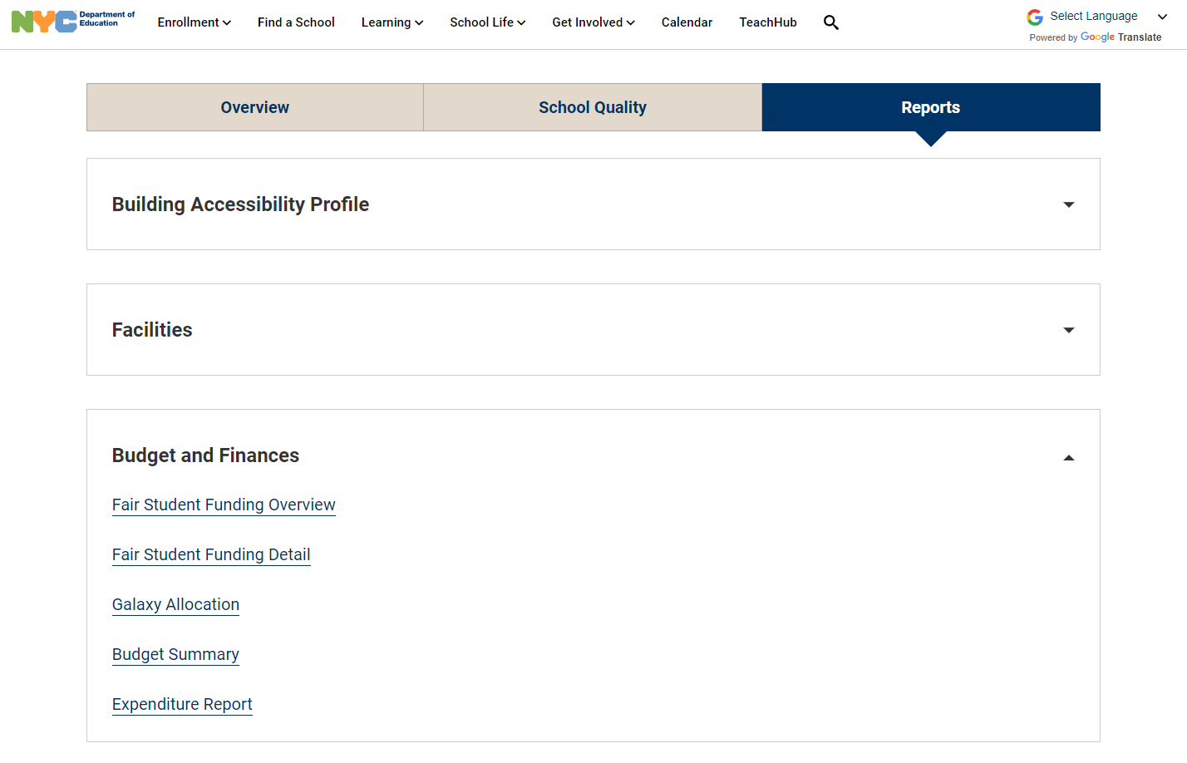
Where can I find information about my school’s budget?
Step 1: Choose a school
Step 2: Select the Reports Tab
Step 3: Open “Budget and Finances”
Step 4: Review reports
  FSF Overview & Detail:
  Fair Student Funding Allocation at the beginning of the year
  Galaxy Allocation: Current budget by source of funding
  Budget Summary: Current budget by use of funding
  Expenditure Report: Summary of spending for the year (after the year is complete)
Notes:
And one final note about the presentation…
While I will be providing an overview of our overall NYC Public Schools’ budget and our district budget, I will not be reviewing our individual school budgets. Those are accessible on our public website.
This slide shows you the steps to find the school budgets from our homepage. I will give you a minute to use this information to load your school-specific budget, if you are interested.
<<MODERATOR TO DROP THE FOLLOWING IN THE CHAT:
“Go to https://schools.nyc.gov and follow the steps on this slide.”>>

Slide 4
Where Does Our Funding Come From?
Our budget for the 2022-23 school year (fiscal year 2023) is $37.6 billion.
We estimate we will spend over $31,000 per student this year.
Other
Federal
$2b
5%
All Other
$0.2b
<1%
Federal
Stimulus
$2b
5%
City
$20b
54%
State
$13b
36%
Funding generally comes from income and corporate taxes, property taxes, and sales taxes.
Per-student figures include students at DOE facilities; excludes Debt Payments, Transportation, and Food. All figures as of FY 2023 Adopted Budget
Draft - Privileged and Confidential
Notes:
I’m now going to provide an overview of our overall budget and where the funding comes from.
Our total budget for the 2022-23 School Year is $37.6 billion, or about $31,000 per student in our system.
New York City provides most of our funding.
For the 2022-2023 school year, the city contributed $20 billion, or 54% of our total budget. Most of our funding from the city comes from what we call “city tax levy” dollars. City tax levy funds are drawn from local taxes (including property taxes, sales taxes, and personal income taxes). Every year, the Mayor proposes the amount of city tax levy funding we get, and the City Council must pass the budget into law.
$13 billion, or 36%, comes from New York State Funding. New York State is our second-largest source of funding. For the 2022-23 school year, the State will contribute $13 billion, or 36% of our total budget. 4 Every year, the Governor proposes the amount of State funding that we will get, mainly based on the number and types of students enrolled in our schools, and then the State Legislature must pass the budget into law. Funding generally comes from income and corporate taxes, as well as property and sales tax.
Federal funding comprises a total of $4 billion dollars of our funding for this school year. The federal government is our third-largest source of funding. The federal government gets its funding mainly from income taxes. Every year, Congress proposes a budget and the President must sign the budget into law. The Every Student Succeeds Act (ESSA), provides the rules for allocating most of the federal funding we receive.
For the 2022-23 school year, the federal government will contribute $2 billion or 5% of our total budget as well as an additional $2 billion, or 5% of our budget, in temporary, federal stimulus funding.

Slide 5
How Is NYC Public Schools’ Budget Spent?
($ in billions)
Off the top:
$10.5 billion goes to employee benefits, pension, and debt
$3 billion goes to state-mandated payments to charter schools
$2 billion goes to non-public & contract schools as per special education mandates
Of the remaining:
$15.1 billion goes to K-12 schools & instruction
$2.2 billion goes to early childhood programs
$4.3 billion goes to school operations
About $300 million – or 1% - goes to our central administrative offices.
Another $300 million – or 1% - goes to superintendents and field offices.
Superintendents
& Field
$0.3, 1%
Central Admin.
$0.3, 1%
Non-Public & Contract Schools
$2.0, 5%
School
Operations
$4.3
11%
K-12 Schools &
Instruction
$15.1
40%
Charters
$3.0, 8%
Employee Benefits,
Pension, & Debt
$10.5
28%
Early Childhood
$2.2, 6%
As of FY 2023 Adopted Budget
Draft - Privileged and Confidential
Notes:
In the previous slide, we covered an overview of where NYC Public Schools receives its funding from and now we will shift into how that funding is spent in our schools and across our system.
The largest proportion of our budget is allocated towards K-12 Schools and instruction. We allocate $15.1 billion dollars (or 46% of our overall budget) annually to support our schools, including health and school climate initiatives, special education and other operating expenses. Most of the Instructional Dollars (over $15 Billion this year) are controlled at the school level.
Within our budget, we have mandated costs that must be covered annually, including employee benefits, pension, and debts, as well as state-mandated payments to charter schools, non-public and contract schools.
We allocate $2 billion to support early childhood across the city.
Finally, our Superintendent/Field Offices and Central Offices, comprise just 2% of our overall budget.
K - 12 Allocations are all dollars given directly to district schools (in addition to associated fringe and pension costs), under the oversight of principals and superintendents. School Budgets are used for all instructional expenses at the DOE. $15.1 billion in school budgets pays for costs including:
• Salaries and benefits for classroom teachers, classroom paraprofessionals, principals, APs, and deans, and other classroom and school-based staff.
• This also includes funding for textbooks, computers, materials, and supplies.
The School Operations section pays for non-instructional services that students receive. The $4.3 billion is used to pay for costs including:
• Free breakfast and lunch available to all students.
• Bus routes.
• Loan payments on buildings (new construction and renovation) – this is similar to mortgage payments.
Non public and contract schools payments covers schools and programs that educate NYC students, but are not directly run by the NYC DOE. The $2b includes:
• Charters
• Students with disabilities attending specialized schools
• Supplemental services to students attending non-public schools
Employee Benefits, Pension and Debt: This $10b pays for:
• healthcare and other employee benefits
Pension payments for staff
Debt payments on loans for school construction and upgrades

Slide 6
District 28 2022-2023 School Budgets
Draft - Privileged and Confidential
Notes:
Now, we are going to look at the financial breakdown for our district. Again, this will not cover the breakdown by schools. You can find that on the NYC Public Schools website by following the directions that we shared at the start of the session.
<<MODERATOR TO DROP THE FOLLOWING IN THE CHAT:
Go to https://schools.nyc.gov and 1. Choose a school, 2. Select the Reports Tab, 3. Open “Budget and Finances,” 4. Review Reports, including FSF Overview and Detail, Galaxy Allocation, Budget Summary, Expenditure Report. >>
As you can see, in District 28 we have a $390 million dollar budget across 51 PK-12 schools serving 34,466 students, including Pre-K Centers. This does NOT include District 75 since those programs are not funded through FSF.
School budgets are comprised of a mix of Fair Student Funding and other funding sources.

Slide 7
Who decides how the money is spent at the school level?
Principals have a great deal of flexibility in deciding how this funding is spent so that they can target it to student and community needs.
Principals along with their School Leadership Teams (SLTs) create the school’s Comprehensive Educational Plan (CEP) based on school specific instructional needs and priorities.
Principals work with their SLTs to create the school’s budget, to pay for the instructional program detailed in the CEP.
Superintendents supervise the Principal in this process and must approve all school budgets and their alignment with the school’s CEP.
Notes:
Who decides how the money is spent at the school level?
Once this funding is in place within school budgets, Principals are responsible for the funds allocated to schools and have a great deal of flexibility in how they spend the funding. These choices are made in partnership with School Leadership Teams (or SLTs).
As Principals and SLTs create the school’s Comprehensive Educational Plan (CEP), they identify school specific instructional needs and priorities and align the school budget to this plan.
Principals work with their SLTs to create the school’s budget, in alignment to the goals and instructional priorities outlined in the CEP.
Superintendents, like myself, supervise all principals in our district through this process and must approve all school budgets and their alignment with the school’s CEP.
<<Superintendent could elaborate here on their vision, priorities, etc.>>

Slide 8
What is Fair Student Funding (FSF)?
Fair Student Funding (FSF) is the largest funding stream that we provide to schools, and it is based on the number of student enrolled at each school + the specific needs of those students.
Student needs are “weighted” based on the cost of meeting a student's educational need (e.g., academic needs, special education needs); and schools get more money for students with greater needs.
FSF makes up about two-thirds of most K-12 NYCPS school budgets.
  Other funding sources include federal funding streams, such as Title I, Title III, IDEA (special-education funding), or other targeted allocations for specific initiatives.
  Charter schools, 3K, PreK, Mandated Individual Education Plan (IEP/special-ed) related services and IEP paraprofessionals (e.g., speech teachers, occupational therapists, and 1:1 paraprofessionals) are funded separately.
FSF provides principals/schools with substantial flexibility to tailor spending to school and community needs. They can use for classroom teachers (including special education teachers and paraprofessionals), guidance counselors, social workers and classroom resources and materials.
Draft - Privileged and Confidential
Notes:
We will now go into more depth around what Fair Student Funding is.
Fair Student Funding, sometimes referred to as FSF, is the largest funding stream that we provide to schools. As discussed on the previous slide, the allocation of Fair Student Funding provided to schools is based on the number of students enrolled at each school and the specific needs of those students.
We make these calculations based on our Fair Student Funding Formula, which calculates how we distribute this overall pot of money to schools.
Within the formula, students with needs that require more support receive more funding, in alignment with those needs.
As indicated in previous slides, Fair Student Funding is a significant proportion of schools’ budgets; in fact, these funds account for nearly two-thirds of most K-12 New York City Public School budgets.
In many cases, schools also receive funding from other funding streams including federal funding streams like Title I, Title III, IDEA (which is funding focused on special education), or other targeted allocations for specific initiatives. These pots make up the remaining funding within the overall school budgets.
As a note, charter schools, 3K and PreK and D75 programs are funded outside of the FSF formula.
Additionally, mandated IEP related services, including speech teachers, occupational therapists and physical therapists as well as 1:1 paraprofessionals are also funded outside of the FSF formula.
Again, the money provided to schools from the Fair Student Funding allocation provides principals with significant flexibility, working in partnership with their SLTs, to utilize the funding to design instructional programs tailored to the needs of their students, within their school community.
Funding from the FSF allocation provides for each school’s basic instructional program and classroom services. This funding can be used to pay for classroom teachers, including arts, gym and cluster teachers (at the elementary level) as well as school leadership, guidance counselors, social workers and administrative and pupil support staff.
Additionally, the FSF allocation can pay for afterschool programs, tutoring and intervention programs as well as teacher absence coverages and classroom resources and materials.

Slide 9
Fair Student Funding:
How Does it Work?
Four Building Blocks Combine to create each school’s FSF Allocation
Foundation
Collective Bargaining
“Per Capita”
Students & Their Needs
Fair Student Funding Allocation
Foundation
Foundation: All schools receive $225,000 each.
Collective Bargaining: Contractual pay increases for school staff.
Per Capita: The dollar value of an FSF student weight of 1. This is updated every year to reflect any changes to the citywide average teacher salary; it was approximately $4,200 this year.
Number of students enrolled at each school, and the specific needs of those students.
  Pupil needs are “weighted” based on the cost of meeting the educational needs.
  See next slide for the table of weights.
Notes:
I want to now use this opportunity to further clarify some of what we have already discussed today.
Throughout this presentation, we have been talking about Fair Student Funding and the Fair Student Funding Formula.
When we say “Fair Student Funding,” we are talking about the money that is allocated to K-12 schools from this large pot, not including pre-k centers or District 75 programs (this year, the FSF Pot is $7 billion dollars). The Fair Student Funding FORMULA is the method by which we decide HOW to allocate that funding to schools. This slide outlines the formula and how we utilize the formula to calculate the total amount of Fair Student Funding that each school receives.
(Note to Facilitator: When reviewing the foundational blocks at the top, remember PEMDAS! Order of Operation here matters!!! Foundation + Collective Bargaining + what's in parentheses!)
Now, I am going to walk you through how we utilize the formula to determine how much Fair Student Funding each school receives and how we determine that specific dollar amount.
Off the top, each school receives a foundational amount of $225,000 annually. This is a baseline funding allocation that is provided to every school, regardless of the number of students that the school serves. Next, we add funding for collective bargaining related costs, which is contractual pay increases for school staff.
Then, we calculate the remainder of the FSF funding by allocating a base amount for each student (“per capita”) and then allocating additional funding based on each student’s identified educational needs and instructional programs. It is in this part of the formula that we take into account the “weights” that we have been referring to throughout the presentation.
On the next slide we will dive more deeply into the weights that we utilize to determine the specific dollar amount that we allocate per student so that you have a clear understanding of what goes into this part of the formula.
I also want to pause here to reiterate that, within this formula, we take the time to examine the individual needs of each student to determine funding allocations. We make these individualized calculations for EACH student, aligned to their individual and specific needs and educational program to determine how much funding would be provided to that school for each student.

Slide 10
SY 2022-2023 Fair Student Funding Weights
Grade Base Weight | Weight
Grades K-5 | 1.00
Grades 6-8 | 1.08
Grades 9-12 | 1.03
 | Academic Intervention | Weight |  | Special Education | Weight
 | Poverty K-12 | 0.12 |  | Low Intensity <=20% | 0.56
 | Below Standards 4-5 | 0.25 |  | Moderate Intensity 21% to 59% | 1.25
 | Below Standards 6-8 | 0.35 |  | Less Inclusive >=60% K-8 | 1.18
 | Below Standards 9-12 | 0.25 |  | Less Inclusive >=60% 9-12 | 0.58
 | Well Below Standards 4-5 | 0.40 |  | More Inclusive >=60% K | 2.09
 | Well Below Standards 6-8 | 0.50 |  | More Inclusive >=60% 1-12 | 1.74
 | Well Below Standards 9-12 | 0.40 |  | Post IEP Transitional Support | 0.12
 | Heavy Graduation Challenge (OAUC) ¹ Over-the-Counter (OTC) 9-12 | 0.40
 |  |  |  | Portfolio High Schools | Weight
 | English Language Learners | Weight |  | Career and Technical Education (CTE) Tier 1 | 0.26
 | Standalone English as a New Language (ENL) K-5 | 0.40 |  | Career and Technical Education (CTE) Tier 2 | 0.17
 | Standalone English as a New Language (ENL) 6-12 | 0.50 |  | Career and Technical Education (CTE) Tier 3 | 0.12
 | Bilingual K-5 | 0.44 |  | Career and Technical Education (CTE) Tier 4 | 0.05
 | Bilingual 6-12 | 0.55 |  | Specialized Academic | 0.25
 | Commanding K-5 | 0.13 |  | Specialized Audition | 0.35
 | Commanding 6-12 | 0.12 |  | Transfer Heavy Challenge (OAUC)¹ | 0.40
 | Students with Interrupted Formal Education (SIFE) | 0.12 |  | Transfer Non-Heavy Challenge | 0.21
¹ Over-Aged and Under-Credited
Notes:
Now, to more deeply understand the CURRENT weights that we use to calculate that last part of the formula from the previous slide.
On this slide are the FSF Weights for the current school year, 2022-2023, or Fiscal Year 2023. Here you can see the different types of weights that students can be eligible to receive, based on their instructional needs or academic programs. Again, these are the weights for this current year.
In previous slides, we mentioned that the Fair Student Funding Working Group has made recommendations for changes to the Fair Student Funding Formula. This is the area where they made recommendations for changes. Later in this presentation, we will show a very similar chart that indicates weight changes that we are proposing for the next school year 2023-2024, Fiscal Year 2024, made as a result of the work of the FSF Working Group.
Now, I will explain the different weights on this slide.
For 2022-2023, the base weight of 1.00 was equal to approximately $4,197 per capita. This per capita is adjusted annually to reflect changes to the citywide average teacher salary.
The basic Grade Weight is allocated to schools for all students on their “audited” (October 31st) register, and is calculated by considering instructional programming requirements by student grade level with distinct weights for K-5, 6-8, and 9-12.
Funding for Academic Intervention (AIS) is determined by student academic performance when they enter a school, using test scores from their prior year. For schools where students do not have incoming test scores in the lower grades - such as before students begin taking tests or if they do not have prior test scores- we provide funding based on a students’ poverty level.
Funding for Special Education is determined by the percentage of time students spend receiving special education services. For example, we have one weight for students receiving services for less than 20% of their week, another weight funding students receiving part-time services for up to 59% of their week, and a final weight for students receiving full-time special education services.
These special education weights are then also broken out by student grade level with the specific weighting value, again, determined based on the cost of providing the instructional program.
We also provide supplemental funding that supports students who have been declassified as special education students. This funding supports students in their first year transitioning out of special education services, through the post-IEP transitional support weight.
Funding for English Language Learners (ELLs) is allocated based on student grade level, reflecting mandated instructional services - including Bilingual and ENL instructional programming. Additionally, we have weights for “former ELLs” who have achieved proficiency within the past two years (indicated using the State-designated term “Commanding”). We also provide funding for ELLs with Students with Interrupted Formal Education (SIFE) status. Students with this classification receive their respective ELL weight, in addition to the SIFE weight.
We also have another category of weights for Portfolio High Schools. These weights are provided to schools based on the number of students who are involved in these academic programs within each high school. Career and Technical weights have different Tiers, based on the type of career preparation program. Programs that require more resources such as nursing, agriculture & veterinary, aviation technology, automotive, culinary, etc., require industry specific equipment, higher level of consumable supplies and materials, student internship requirements that are integral to the program of study and highly specialized and ongoing industry training for teachers, have higher weights to support that instructional programming.
There are also separate weights for students in specialized academic or specialized audition schools and for students attending transfer schools. Only students attending high schools are eligible for these weights.

Slide 11
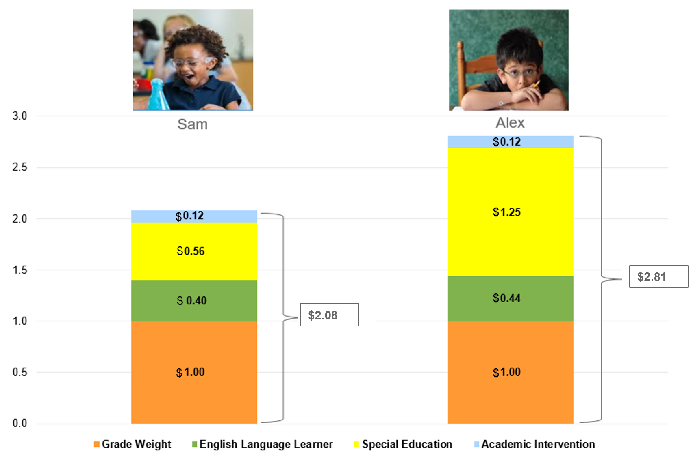
How The FSF Weights Work – If the Per Capita Were $1
Grade Weight
English Language Learner
Special Education
Academic Intervention
Portfolio Weight (HS only)
Notes:
We just took a look at all of the weights that students could be eligible to receive within the Fair Student Funding Formula allocation. I also shared that, as we are calculating that formula for each school, we take into account the instructional needs of each individual student within the school as we determine schools’ overall budget allocations. In this slide, we will take a look at how each students’ calculation is determined. The different types of weights are indicated, by color, in the upper right corner of the slide.
In order to determine the weight for each student, we evaluate their eligibility for the weight, based on data in NYC Public School systems that store key information about students.
Now, we are going to walk you through the process for how Fair Student Funding would be allocated for two students, Sam and Alex, through the Fair Student Funding Formula.
Sam and Alex are two students who attend an elementary school in our district.
The orange section shows the Grade Weight that they first receive. Because they are elementary students, they are both entitled to the K-5 grade weight of 1.0, again, shown in the graph in orange.
If they were middle school students, they would have a weight of 1.08. And if they were high school students, they would receive a weight of 1.03.
Both Sam and Alex are classified as English Language Learners (ELLs) – shown in green.
Sam is an elementary school multi-lingual learner, enrolled in a standalone English as a New Language (ENL) program. Therefore SAM is entitled to the K-5 ENL weight of .40
Alex is also an elementary school multi-lingual learner. Alex is enrolled at a bilingual program at his school. The school has appropriately coded Alex as enrolled in a bilingual program in the NYC Public Schools’ scheduling system (STARS). As such, Alex is entitled to the K-5 bilingual weight of .44
Both students are students with disabilities, requiring special education classroom instructional services (of Special Education Teacher Support Services (SETSS), Special Class (SC) or Integrated Co-Teaching (ICT)).
Sam’s Individualized Educational Program (IEP) requires less than 20% of Sam’s instructional program to be in an IEP setting, therefore Sam is entitled to the <20% special education weight of .56, shown in yellow.
Alex’s Individualized Educational Program (IEP) 21%-59% of Alex’s instructional program to be spent in an IEP setting; therefore Alex is entitled to the 21%-59% special education weight of 1.25, shown in yellow.
Both students are students in poverty, therefore they are entitled to the FSF Academic Intervention weight of .12, shown in blue.
When you add all the pieces together, Sam’s allocation through the FSF Formula would total a weight of 2.08; while Alex’s allocation total 2.81. Because each weight of 1.0 is equal to $4,137; Sam’s weight of 2.08 is equal to approximately $8,600, while Alex’s weight of 2.81 is equal to approximately $11,600 under the FSF formula.

Slide 12
MOVING FORWARD –
Notes:
And now that we’ve gone into great depth on the Overall NYC Public Schools budget for the current school year, as well as the current Fair Student Funding Formula, I am going to review what is ahead for the next fiscal year FY24, which aligns to the 2023-2024 school year.

Slide 13
Improving Fair Student Funding (FSF) (1 of 2)
While our funding methodology directs additional resources to schools with many high-need students....
  For example, we know that our schools with the highest share of students in poverty have received an average of 26% more per capita funding than our schools with the lowest share of students in poverty.
  Similar patterns exist for students in temporary housing (27%), students with disabilities (36%) and English language learners (14%).
Notes:
There are some common misconceptions around the Fair Student Funding formula and how it allocates resources to schools and students. Our analyses show that by and large, the Fair Student Funding Formula is very effective at directing more resources to students that have greater needs.
As noted on the slide, through the Fair Student Funding Formulas, our schools with the highest share of students in poverty receive 26% more per capita funding than our schools with the lowest share of students in poverty.
Further, our analyses show that similar patterns exist for schools with students in temporary housing, students with disabilities and English language learners.
And, while our data show that the way we calculate Fair Student Funding allocations through the Fair Student Funding Formula is equitable…

Slide 14
Improving Fair Student Funding (FSF) (2 of 2)
We believe improvements can be made to FSF.
As a result, the Chancellor created a working group, which met this summer and fall and issued their final recommendations in early November.
The Working Group was tasked with:
  Reviewing and making recommendations relating to the Fair Student Funding formula, including the categories, types of students, grade levels, and weights within the formula, in order to best meet the needs of students citywide, while keeping equity at the core of our work.
  The group met biweekly both by video and in-person, and reviewed models created by both DOE and the IBO to look at the impacts of the proposed recommendations.
  Developing recommendations in time to inform the FY 2024 FSF formula
Notes:
We do believe that improvements can be made to the Fair Student Funding Formula.
As discussed briefly earlier in the presentation, in Summer 2022, the Fair Student Funding Working Group was formed in response to Chancellor Banks’ request to examine the FSF Formula and make suggestions for improvements to it.
Over the course of four months, the group worked in partnership with national experts and our NYC Public Schools team to analyze and identify a series of recommended changes to the formula, as well as aligned policy recommendations.
The Working Group was tasked with reviewing and making recommendations relating to the Fair Student Funding formula, including the categories, types of students, grade levels, and weights within the formula, in order to best meet the needs of students citywide, while keeping equity at the core of the work.​
The Working Group published a report with recommendations for changes to the formula in November 2022. All of the working group’s materials, including the presentations, meeting minutes and the final report are available on our website at the link provided in the chat.
<<MODERATOR DROP THIS LINK IN THE CHAT: https://infohub.nyced.org/reports/financial/financial-data-and-reports >>

Slide 15
The Chancellor Has Accepted, and Is Proposing, The Following Recommendations from the Working Group:
New weight to support Students in Temporary Housing (STH)
Why this weight: Research shows that the situations faced by students in temporary housing create significant challenges to student success.
How the weight works: Weight of 0.12 times the FSF per capita for the number of students in temporary housing in the school in the prior year.
New weight to support schools with high percentages of student need, concentration weight.
Why this weight: Having high concentrations of needy pupils has a negative impact on student achievement.
How the weight works:
Schools are ranked based on their proportion of student needs (e.g., students with disabilities, English Language Learners, students living in poverty, students in temporary housing, and others).
  Schools with the highest average student need are divided into 3 categories (tier 1, tier 2, and tier 3). Schools outside of the highest concentration receive no funding.
  Students attending schools in tier 1 receive a weight of 0.04, tier 2 0.08, tier 3 0.12.
  Concentrations weight times the school’s average need for the prior year, times the register for the school year.
Notes:
Moving forward, the Chancellor has accepted and is proposing two changes to the Fair Student Funding Formula, which I will now discuss.
We are first proposing to add a Students in Temporary Housing weight to the FSF formula
This weight would provide additional funding to schools for students who are identified as Students in Temporary Housing.
This marks a significant shift in how we allocate resources to our students, with this specific focus on supporting students who reside in temporary housing. This will have an impact on our asylum-seeking families who are living in temporary housing, providing additional resources to the schools who are taking them in.
<<Superintendents can consider tailor more TPs based on the impact of this weight in their district.>>
This was the top recommendation from the FSF Working Group and is expected to drive $45 million in funding, impacting students in temporary housing across all five boroughs.
We will better understand how much funding we will be receiving in our district by late spring when initial allocations are released.
Secondly, we are proposing to add a concentration weight to the FSF Formula:
The concentration weight would provide additional funding to schools with high populations of students with significant needs.
Research shows that schools that serve higher concentrations of students with high needs (such as students in poverty, students with disabilities, English language learners) require additional resources to provide robust education and appropriate resources and supports to their students.
<<Superintendents can consider tailor more TPs based on the impact of this weight in their district.>>
This weight is expected to drive $45 million in funding to schools in all five boroughs and would impact over 300 schools across the city serving the highest concentration of our neediest students.
We will better understand how much funding we will be receiving in our district by initial allocations (late in the spring).
The concentration weight includes factors for proposition of students who are in poverty, consistent with the Working Group’s suggestion that we look at poverty in our weights; students with disability and students who are in temporary housing and other indicators.

Slide 16
The Chancellor Has Also Accepted Additional Recommendations from the Working Group Which Do Not Directly Impact Fair Student Funding Weights
In response to some other challenges identified by the Working Group, NYC Public Schools will do the following:
Enhancing the budget appeals process to ensure it is responsive to schools’ special education staffing needs.
Strive to improve budget transparency around both the FSF formula and NYC Public Schools’ budget as a whole.
Notes:
In addition to changes to the weights outlined in the previous slide, the Chancellor has also accepted additional recommendations from the Working Group.
Moving forward, NYC Public Schools will be:
Prioritizing budget appeals process to be responsive to Special Education programming
Throughout the engagement sessions, the Working Group shared the critical need for schools to receive funding for all of the programmatic needs of students with disabilities in a general education setting. Understanding that there are changes to special education programming that may be impacted by changing enrollment at schools, we will be prioritizing supporting small schools and schools with high proportions of students with disabilities in the budget appeals process.
While this was not a recommendation in the working group’s final report, we heard this as a significant issue from many members of the working group and wanted to be responsive to the needs of the group.
We will be working as a system to increase our transparency around school budgets.
We also heard concerns over a lack of transparency and understanding in how we fund schools, how the formula works and what funds are available at the school level.
We are taking steps to address this by being more thoughtful around how we present information to the public and ensure that through presentations and on our website that information is more accessible to all our stakeholders, including making significant changes to presentations, like this one!
In order to decide on which recommendations to choose, we carefully considered the recommendations of the working group and looked closely at the impacts of each recommendation. The working group was clear with their values - that we have more work to do to direct funding to our schools with the greatest needs.
We selected these proposals by balancing the values of equity and stability, looking to direct additional resources towards our schools and students with our highest needs while ensuring that schools do not see disruptions to existing resources.
As a note, schools will not lose money as a result of these proposals. We are not reducing any weights to schools to fund this proposal.

Slide 17
SY 2023-2024 Proposed Fair Student Funding Weights
Grade Base Weight | Weight
Grades K-5 | 1.00
Grades 6-8 | 1.08
Grades 9-12 | 1.03
Academic Intervention* | Weight
Poverty K-12 | 0.12
Below Standards 4-5 | 0.25
Below Standards 6-8 | 0.35
Below Standards 9-12 | 0.25
Well Below Standards 4-5 | 0.40
Well Below Standards 6-8 | 0.50
Well Below Standards 9-12 | 0.40
Heavy Graduation Challenge (OAUC) 2 Over-the-Counter (OTC) 9-12 | 0.40
New Weights | Weight
Students in Temporary Housing | 0.12
Concentration Need Tier 3 | 0.12
Concentration Need Tier 2 | 0.08
Concentration Need Tier 1 | 0.04
English Language Learners | Weight
Standalone English as a New Language (ENL) K-5 | 0.40
Standalone English as a New Language (ENL) 6-12 | 0.50
Bilingual K-5 | 0.44
Bilingual 6-12 | 0.55
Commanding K-5 | 0.13
Commanding 6-12 | 0.12
Students with Interrupted Formal Education (SIFE) | 0.12
Portfolio High Schools | Weight
Career and Technical Education (CTE) Tier 1 | 0.26
Career and Technical Education (CTE) Tier 2 | 0.17
Career and Technical Education (CTE) Tier 3 | 0.12
Career and Technical Education (CTE) Tier 4 | 0.05
Specialized Academic | 0.25
Specialized Audition | 0.35
Transfer Heavy Challenge (OAUC)¹ | 0.40
Transfer Non-Heavy Challenge | 0.21
Special Education¹ | Weight
Low Intensity <=20% | 0.56
Moderate Intensity 21% to 59% | 1.25
Less Inclusive >=60% K-8 | 1.18
Less Inclusive >=60% 9-12 | 0.58
More Inclusive >=60% K | 2.09
More Inclusive >=60% 1-12 | 1.74
Post IEP Transitional Support | 0.12
¹ Over-Aged and Under-Credited.
Notes:
This chart, similar to one shown earlier, now includes the Proposed New Weights for next school year.
What is listed here in the blue hi-lighted section in the top right-hand table are the proposed changes to the FSF Weights for the next school year. That means, if approved by the Panel for Education Policy (PEP) in April, these new weights will be used to calculate the schools FSF allocation for the 2023-2024 school year.
If approved by the PEP, there is no impact to the current school year budgets. New weights would be calculated and impact schools budgets by initial allocations for FY 2024

Slide 18
School Budgeting Timeline
February & March: Based on initial budget estimates of City and State revenue, the DOE presents the CECs with the proposed Fair Student Funding weights for the coming school year. The presentation tonight serves to advise CECs and school district communities of the formula and if there are any proposed changes. This presentation is also posted on the DOE’s website at https://infohub.nyced.org/reports/financial/financial-data-and-reports.
March: The Panel for Educational Policy votes on the Estimated Budget for 2023-2024, based on the City’s Preliminary Budget.
April: The Panel for Educational Policy votes on the proposed Fair Student Funding weights for the coming school year.
Late Spring: DOE releases budget allocations to schools.
June: Principals along with their School Leadership Teams propose budgets for the coming year.
July: Superintendents must certify alignment between school budgets and Comprehensive Educational Plans (CEPs) for the coming year.
September: The new school year begins!
Notes:
And now, here is our timeline for moving forward.
In February & March, given initial budget estimates of City and State revenue, NYC Public Schools Superintendents present the CECs with the proposed Fair Student Funding weights for the coming school year. (That is this presentation!)
In April and May, The Panel for Educational Policy votes on the proposed Fair Student Funding weights for the coming school year.
In Late Spring, NYC Public Schools will release budget allocations to schools.
In June, Principals along with their School Leadership Teams propose budgets for the coming year.
In July, I and my team will certify alignment between school budgets and Comprehensive Educational Plans (CEPs) for the coming year.
In September, The new school year begins!

Slide 19
Future Changes & Feedback
We are continuing to review the formula to address other concerns we have heard about school budgeting in future years – including challenges related to school size and enrollment shifts.
We value your feedback!
    Comments and questions may be directed below by April 18, 2023.
    Via email to
    BudgetPublicComments@schools.nyc.gov
    – OR –
    By phone to (212) 374-6754.
Notes:
All public comments will be reviewed by NYC Public Schools teams. Public questions and comments related to the FSF formula will be posted on the Panel for Educational Policy (PEP) website.
Analysis and response of each relevant question and comment will be available for review on the FSF website in advance of the April 18 vote.
Comments and questions may be directed to the following email address or phone number by April 18th, 2023.
<<MODERATOR DROP THE FOLLOWING IN THE CHAT or SHARE WITH AUDIENCE:
“Send public comments to BudgetPublicComments@schools.nyc.gov ​– OR – ​By phone to (212) 374-6754” >>
I thank you tremendously for your time and attention today. Thank you for sharing your questions throughout the presentation in the chat. We will be gathering any unanswered questions and sharing back responses within a few days.
If you have any additional questions that I can support in answering, please reach out to me/my team member at TKTKTKTK.
<<MODERATOR DROP THE FOLLOWING IN THE CHAT or SHARE WITH AUDIENCE:
(insert Superintendent email address/phone number>>
Thank you again!

Slide 20
QUESTIONS?

Slide 21
More Information Is Available Online About:
Fair Student Funding, School Budgets, and the FSF Working Group
You can find the following online on the DOE’s “Infohub,” under “Reports >> Financial Data and Reports”:
  Detailed information about each and every school budget allocation in the form of “school allocation memoranda” or “SAMs.”
  A summary of each school's total and Fair Student Funding budget along with student and staff counts.
  A programmatic guide to Fair Student Funding, as well as how the FSF allocation is calculated for each school.
You can find the following online on each individual school webpage, under “Reports >> Budget and Finances”: (see directions on slide 3)
  Detailed information of the school’s budget based on the different types of funding schools receive, and
  Detailed information as to how the Principal has budgeted for the current year, including the number of staff positions and other planned spending.

